Slide 1
Data Analysis for GPA Trends
Joshua Suo

Slide 2
Summary of GPA Dataset Variables
Demographics and Background
State of origin
Major
Age they started programming
Private school attendance
Scholarships
Number of parents in the tech field
Study Habits
Studying with friends
Note taking habits
Credits taken previous semesters
Time Use
Average screen time
Average hours of sleep

Slide 3
Dataset Cleanup
Blank values were replaced with the mode value of that column
Average screen time
Values such as 60, 90, 120, 323 included
Fixed by dividing these values by 24 if between 24 and 150
Fixed by dividing these values by 60 if over 150
Important to note that some GPA values were also blank, so there will be repeated GPA values that will differ from the actual, which changes the results of the findings

Slide 4
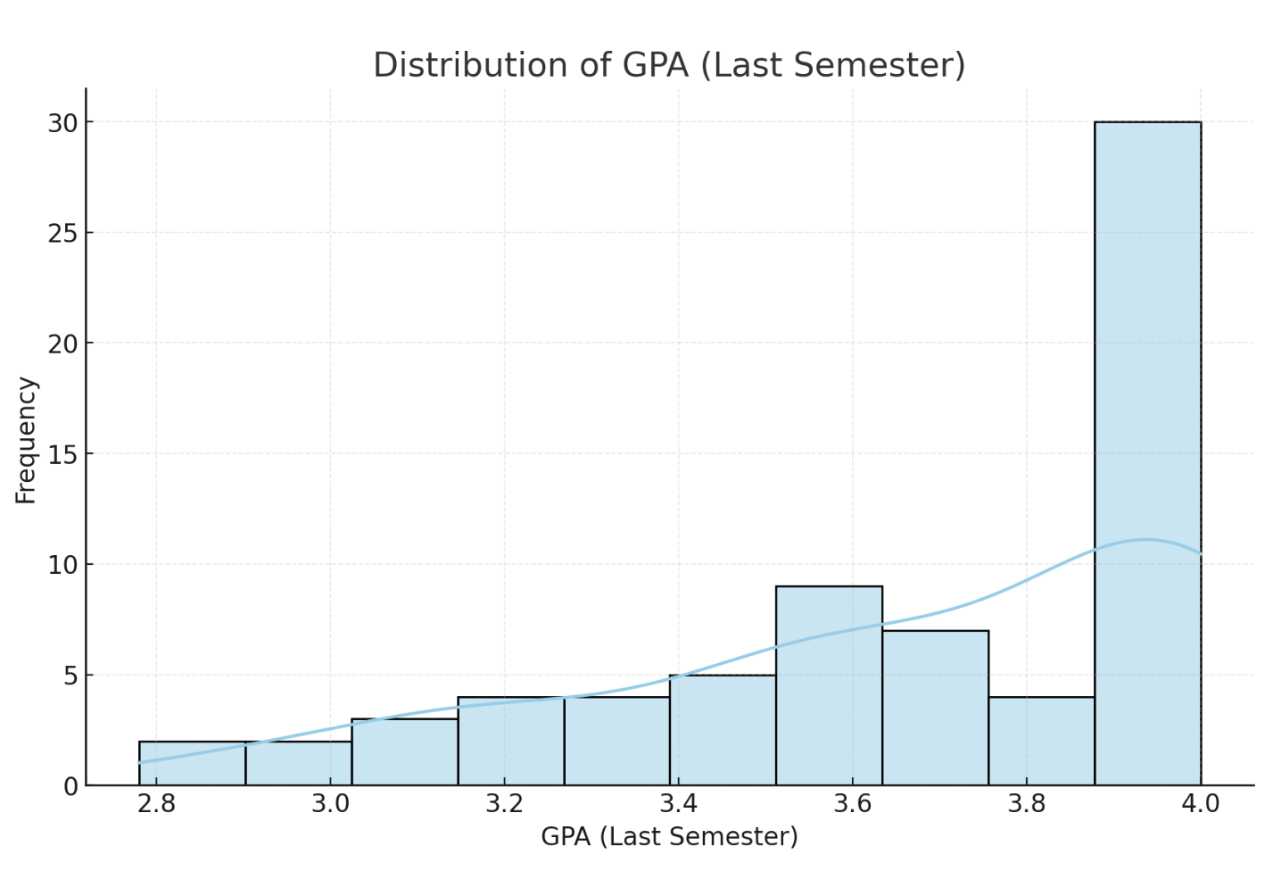
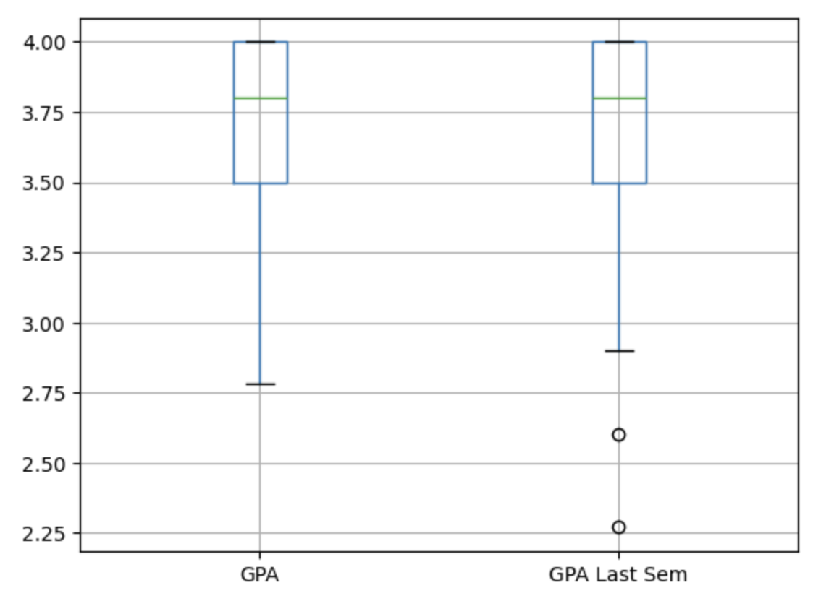
GPA Distribution (Last Sem)
Mean: 3.67
Std Dev: 0.34
IQR: [3.5, 4.0]
Min: 2.78
Max: 4.0
Compared to previous semester:
Mean: 3.65
Std Dev: 0.39
IQR: [3.5, 4.0]
Min: 2.27
Max: 4.0

Slide 5
Statistical Tests
Spearman Test
Tests determines the strength and direction of the relationship between two variables
Dataset does not have a linear relationship
Independent T Test
Test determines significant differences between mean of two groups
Assume normality because n > 30
ANOVA Test
Test determines significant differences between mean of multiple groups (>2)
Assume normality because n > 30

Slide 6
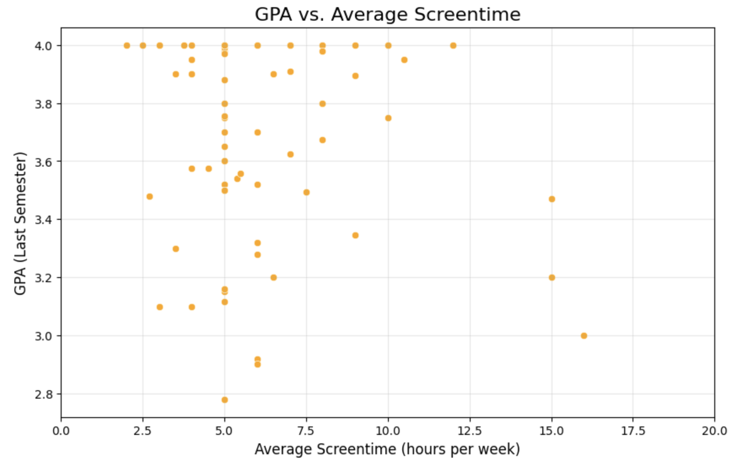
AVG Screen Time (hours) vs GPA
Spearman test:
Test stat: -0.04
Shows very weak negative relationship
P value: 0.691
Greater than 0.05, not statistically significant
Scatter plot
Moderate screen time (<10 hours)
Correlates to higher GPAs
Higher screen time (>10 hours)
More scattered
Slightly lowered GPAs

Slide 7
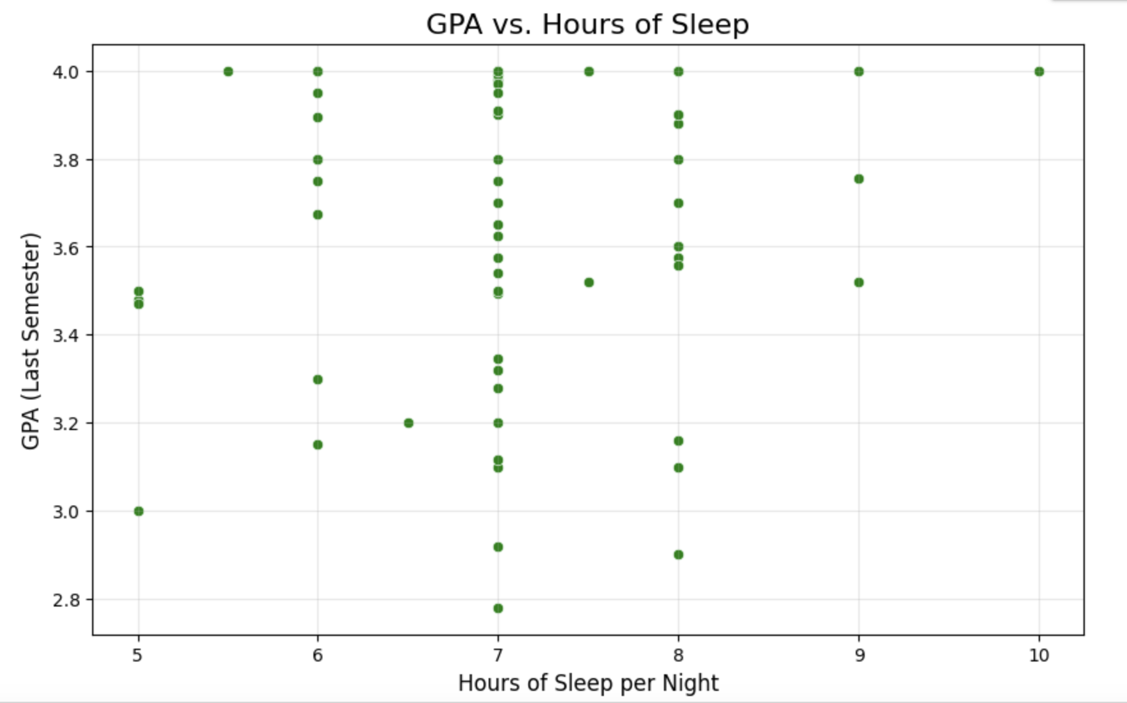
AVG Sleep (hours) vs GPA
Spearman test:
Test stat: 0.218
Shows weak positive relationship
P value: 0.064
Greater than 0.05, not statistically significant
Scatter plot
Sleep hours (7-8 hours)
Correlates to higher GPAs
Lower hours of sleep (<7 hours)
More scattered
Slightly lowered GPAs

Slide 8
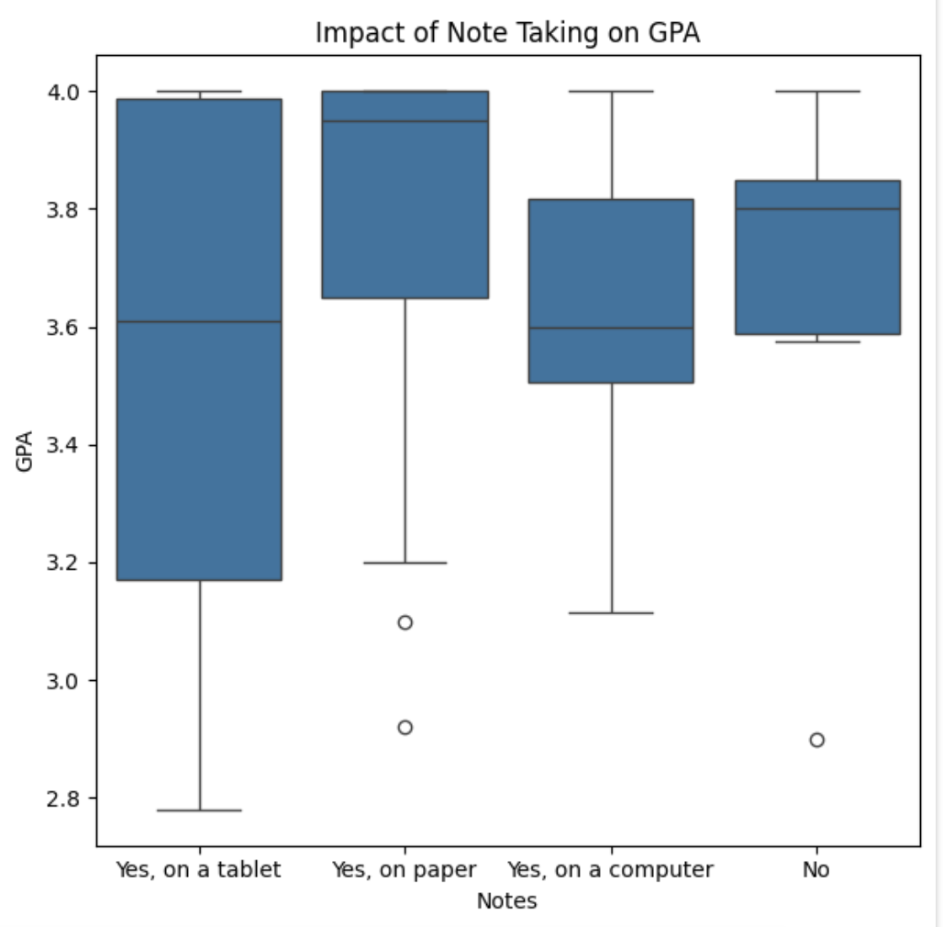
Taking notes vs GPA
Independent T Test (Two groups: Yes/No)
P value: 0.81685
Greater than 0.05, not statistically significant
ANOVA Test (multiple groups)
P value: 0.1325
Greater than 0.05, not statistically significant
Box Plot
The majority of all GPA are between the 3.6-3.8 mark
No statistically significant influence

Slide 9
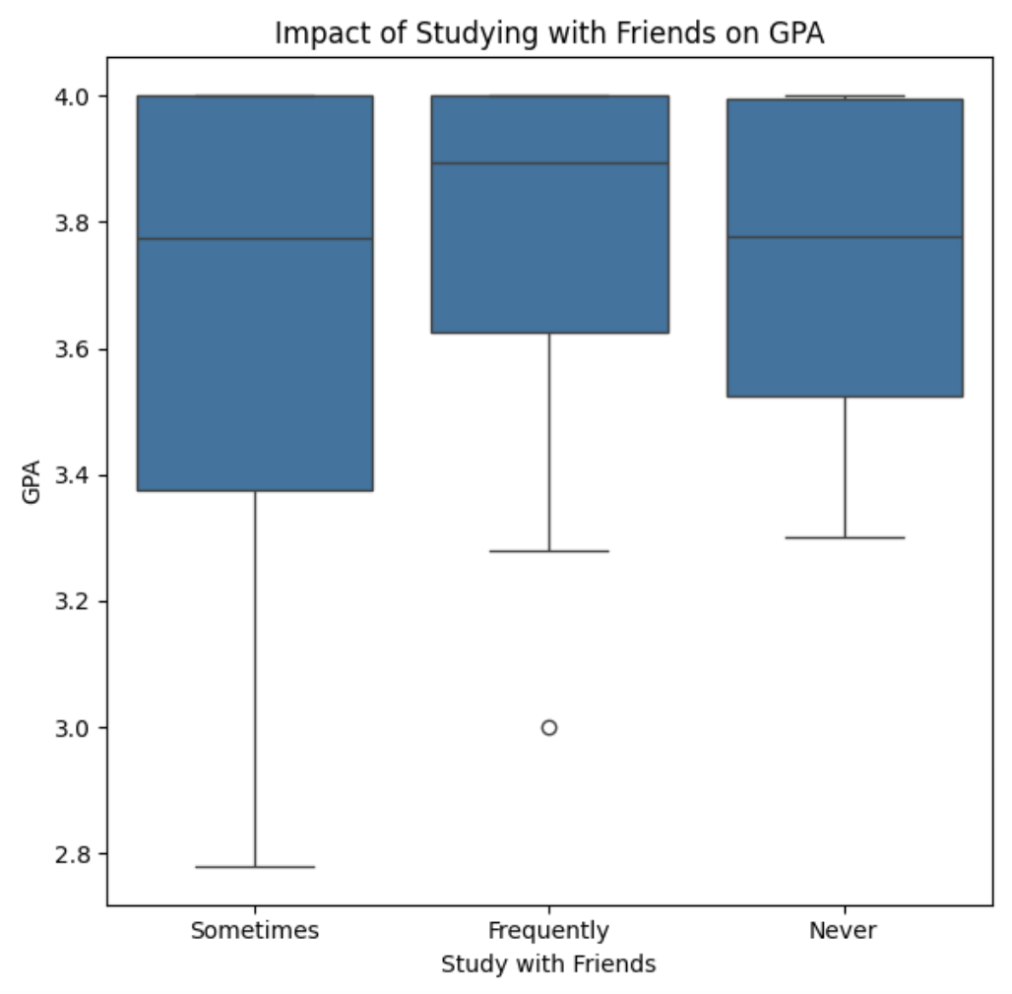
Studying with Friends vs GPA
Independent T Test (Two groups: Yes/No)
P value: 0.48449
Greater than 0.05, not statistically significant
ANOVA Test (multiple groups)
P value: 0.4854
Greater than 0.05, not statistically significant
Box Plot
The majority of all GPA are between the 3.6-3.9 mark
No statistically significant influence

Slide 10
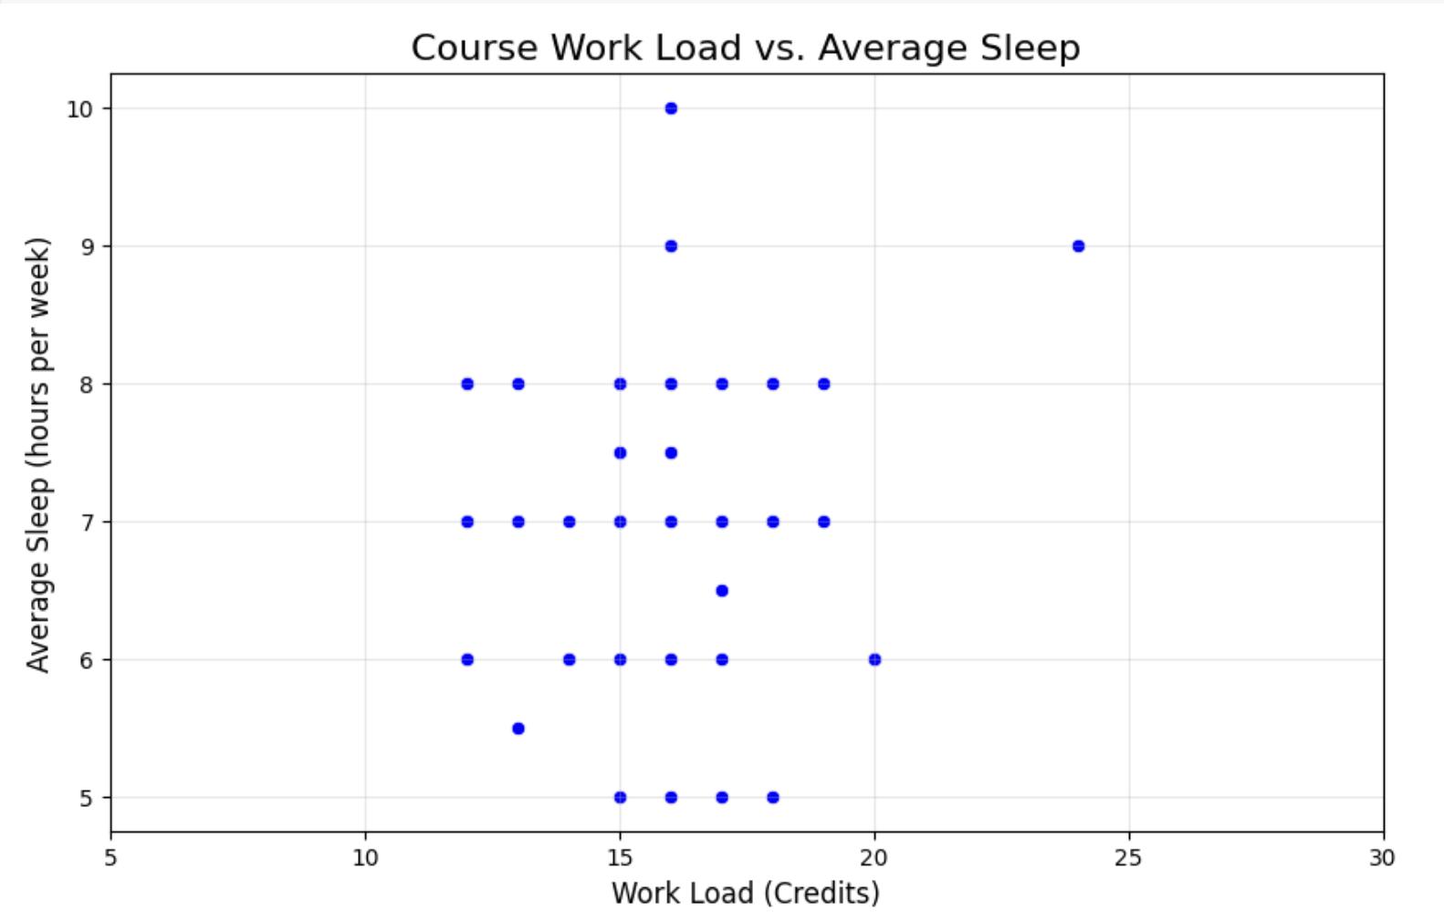
Course workload vs AVG Sleep (hours)
Spearman test:
Test stat: 0.033
Shows weak relationship
P value: 0.7788
Greater than 0.05, not statistically significant
Scatter plot
Majority of workload between 12-18
Majority of hours slept between 6-8
No statistically significant impact of workload and hours of sleep
Outliers at 9 and 10 hours of sleep

Slide 11
Conclusion
GPA influencers:
Positive (increase of variables correlates to increased GPA)
Taking notes
Studying with friends
Hours of Sleep time
Negative (increase of variables correlates to decreased GPA)
Average screen time
Heavier course load
All variables had an influence, but no statistically significant relationship between any variables
Notes:
Though there are positive and negative relationships between GPA and other variables, there is not statistically significant impact of these variables on GPA
In addition, heavier workload associated with reduced sleep, but did not have a direct effect on GPA

Slide 12
Next Steps
Actionable steps:
Have balanced study habits and reduce screen time
Encourage better sleep habits
Future:
Explore other variables
Stress / stress management
Time management
Long term studies
Not just one semester or one year

